Slide 1
Python programming
unit 3a – recursion

Slide 2
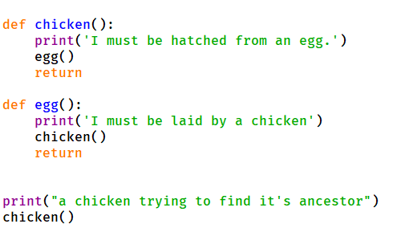
What is recursion
Function call loop
When a function call itself
When a function call other function, but other function finally calls back to this function again
It can be infinite and never return if the loop cannot break

Slide 3
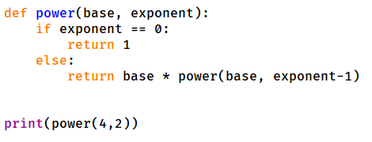
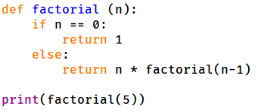
What is recursion
In the Function call loop
Each time the conidiation should have slight difference
When the condition reaches certain value, then it does not need continue to call, can find the result and return

Slide 4
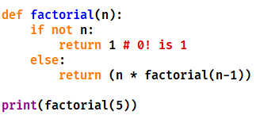
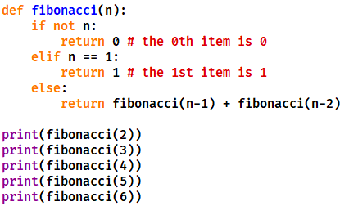
Recrusion usage
Sometimes recursion can result in very easy and clear code.

